Slide 1
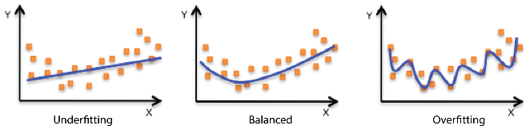
Image source - Internet
Notes:
https://docs.aws.amazon.com/machine-learning/latest/dg/model-fit-underfitting-vs-overfitting.html
https://towardsdatascience.com/overfitting-and-underfitting-principles-ea8964d9c45c
In supervised learning, underfitting happens when a model unable to capture the underlying pattern of the data In supervised learning, overfitting happens when our model captures the noise along with the underlying pattern in data

Slide 2

Data Mining for Business Overfitting and Underfitting Bias and Variance Trade-off
Dr. Shipra Maurya
Department of Management Studies
IIT (ISM) Dhanbad
Email: shipra@iitism.ac.in

Slide 3
Overfitting and Underfitting
To understand the root cause for poor model performance, it is important to understand the model fit
Underfitting : means model performance is poor on the training data and can not be generalized to the new data (validation set/ holdout set)
Overfitting : means model performance is too good on the training data but is poor on validation and holdout set
Image source - Internet
Notes:
https://docs.aws.amazon.com/machine-learning/latest/dg/model-fit-underfitting-vs-overfitting.html
https://towardsdatascience.com/overfitting-and-underfitting-principles-ea8964d9c45c
In supervised learning, underfitting happens when a model unable to capture the underlying pattern of the data In supervised learning, overfitting happens when our model captures the noise along with the underlying pattern in data

Slide 4
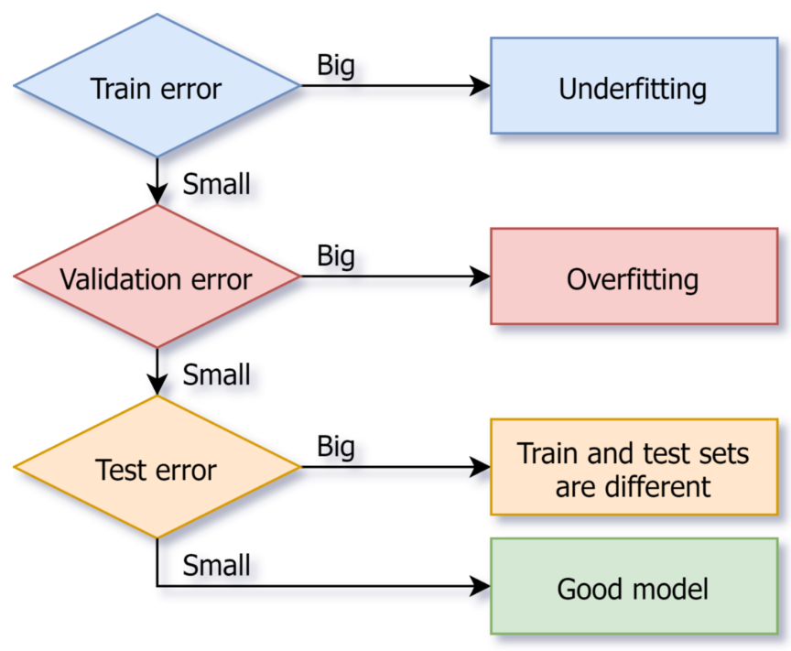
How to detect Overfitting and Underfitting?
Image source - Internet

Slide 5
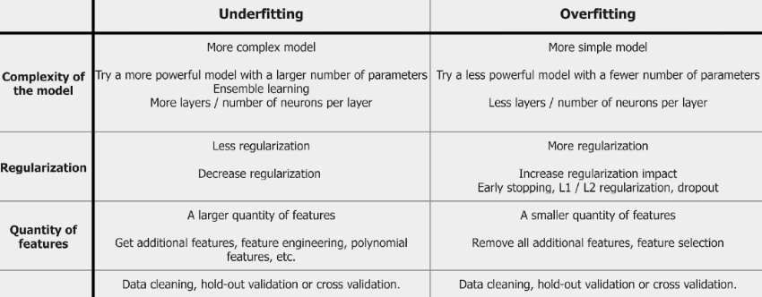
Techniques to overcome Overfitting and Underfitting
Data
Image source - Internet

Slide 6
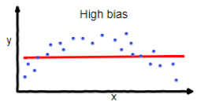
Bias and Variance Trade-off
Bias and variance are prediction errors. These are important to understand the model performance
Bias –
the difference between the prediction and actuals.
Model with high bias pays very little attention to the training data and oversimplifies the model.
It always leads to high error on training and test data
Image source - Internet
Notes:
https://towardsdatascience.com/understanding-the-bias-variance-tradeoff-165e6942b229
How to measure the model’s bias-variance?
After k-fold cross validation, we’ll get k different model estimation errors (e1, e2 …..ek). In an ideal scenario, these error values should sum up to zero. To return the model’s bias, we take the average of all the errors. Lower the average value, better the model.
Similarly for calculating the model variance, we take standard deviation of all the errors. A low value of standard deviation suggests our model does not vary a lot with different subsets of training data.
We should focus on achieving a balance between bias and variance. This can be done by reducing the variance and controlling bias to an extent. It’ll result in a better predictive model. This trade-off usually leads to building less complex predictive models as well.

Slide 7
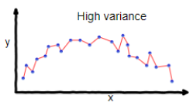
Bias and Variance Trade-off
Variance –
Variance is the variability of model prediction for a given data point which tells us spread of our data.
Model with high variance pays a lot of attention to training data and does not generalize on the data which it hasn’t seen before.
As a result, such models perform very well on training data but has high error rates on test data.
Image source - Internet
Notes:
An optimal balance of bias and variance would never overfit or underfit the model

Slide 8
Why Bias and Variance Trade-off?
A too simple model with few features may suffer from High Bias and Low Variance
A complex model with many features may suffer from Low Bias and High Variance
This tradeoff in complexity is why there is a tradeoff between bias and variance. An algorithm can’t be more complex and less complex at the same time
Notes:
https://towardsdatascience.com/understanding-the-bias-variance-tradeoff-165e6942b229

Slide 9
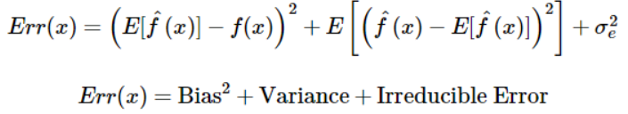
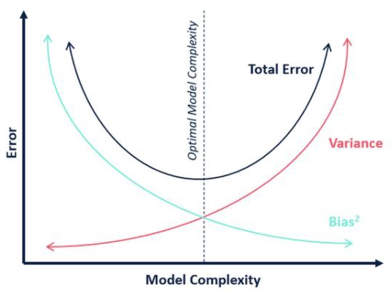
Why Bias and Variance Trade-off?
Aim is to build a good model which minimizes the total error
Image source - Internet
Notes:
https://towardsdatascience.com/understanding-the-bias-variance-tradeoff-165e6942b229

Slide 10
Thank you!

Slide 11
